Slide 1







OS Health
Marwan Maged 211000328
Mohamed Noaman 211001320
Andrew Fayek Fayez 211001767
Mahmoud Samy Farouk 211001642
Mowafak Mahaini 211002094
Zahraa Mohamed Mosa 211001602
DR.Ahmed Elnokrashy

Slide 2



Introduction
This project aims to develop a user-friendly application in C# for Windows system maintenance. The application will focus on optimizing system performance by addressing common issues such as memory usage, cleaning temporary files, and managing startup programs.

Slide 3


Objectives
Q1
Q2
Q3
Design a user-friendly GUI for easy interaction.
Implement functionalities to identify and clean temporary files, optimize memory usage, and optimize startup programs.
Provide users with a simple interface to initiate system maintenance tasks.

Slide 4
Functionalities
Identify and Clean Temporary Files
Implement Memory Management Techniques
Optimize Startup Programs and Services
User-Friendly Interface

Slide 5
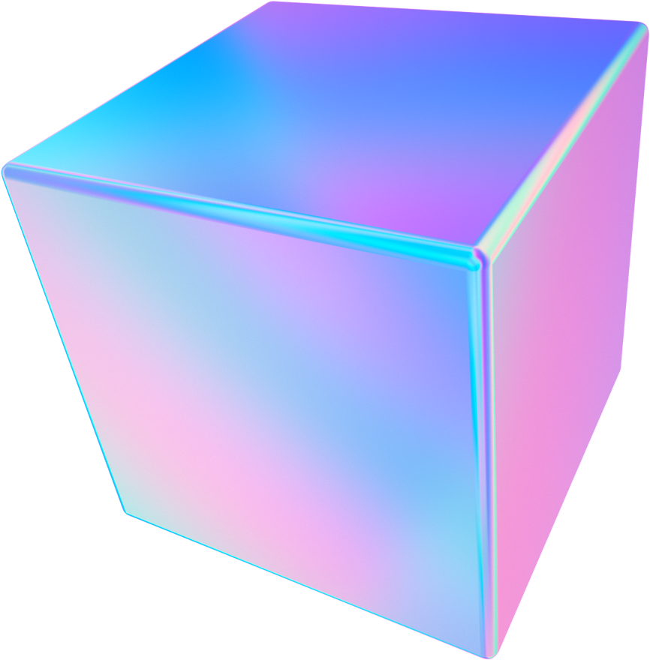
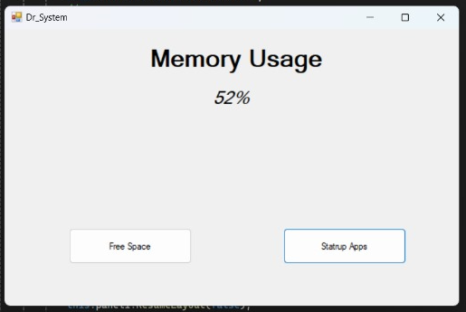

implementation
Free Space Button
Purpose: Allows users to reclaim unused memory.
Functionality: When clicked, it identifies and releases memory blocks that are no longer in use.
Benefits: Improves memory utilization and reduces fragmentation.

Slide 6
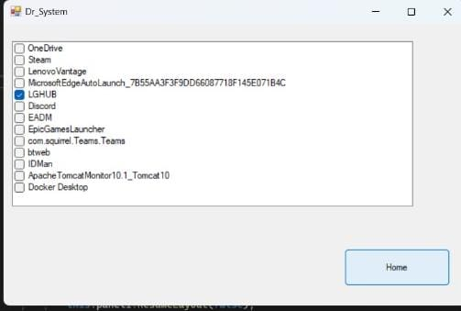
implementation
Startup Apps Button
Purpose: Manages applications that automatically launch when the operating system starts.
Functionality: Allows users to enable or disable specific apps from starting automatically.Provides control over system resources during startup.
Benefits: Faster boot times by reducing the number of simultaneous app launches.Improved system performance by preventing resource-intensive apps from starting unnecessarily.

Slide 7
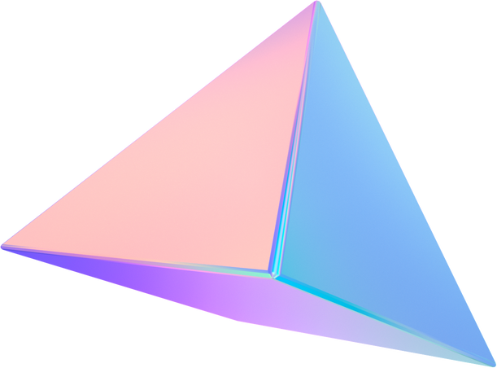

Conclusion
The proposed Windows System Maintenance Application will provide users with a convenient solution for optimizing system performance through tasks such as
cleaning temporary files
managing memory usage
optimizing startup programs
The project will be developed in C# with a focus on simplicity, usability, and effectiveness in improving system performance.

Slide 8
Thank You

